Slide 1


Theory Rev. +Economic Survey Vol.2 + Vol.1 + Budget 2016
1.Banking Finance
6.HRD
2.Budget-Fiscal Policy
3.BoP
4.Sectors of Economy
5.Infra
V2C2-Pub.Fin; V1C3-JAM
V2C3-Monetary mgmt+FI
V2C4-External sector
V2C5-Price,Agri.; V2C6,7
V2C8-Paris Summit, Energy
V2C9-Social infra.
V1C4-Agri ; V1C9-Fertilizer
V1C5-mother-child
V1C6-bounties; V1C7-Fiscal Cap
V1C8-PTA
V1C2-Chakravy; V1C10-Labour
V1C11-Powering 1 India
B1. Financial Sector Reforms
B2. Fiscal Discipline
B3. Tax Reforms; B4. Ease of
B5. Agro: 2x farmer income
B6. Rural infra-employment
B7. Infrastructure
B8. Social Sector & healthcare
B9. Education, Skills, Jobs
V2C1- Chakravyuh challenge
V1C1- Twin Balancesheet
IYB:7-Commerce
Agri
Mfg
MicroEcon
GDP Inflation

Slide 2
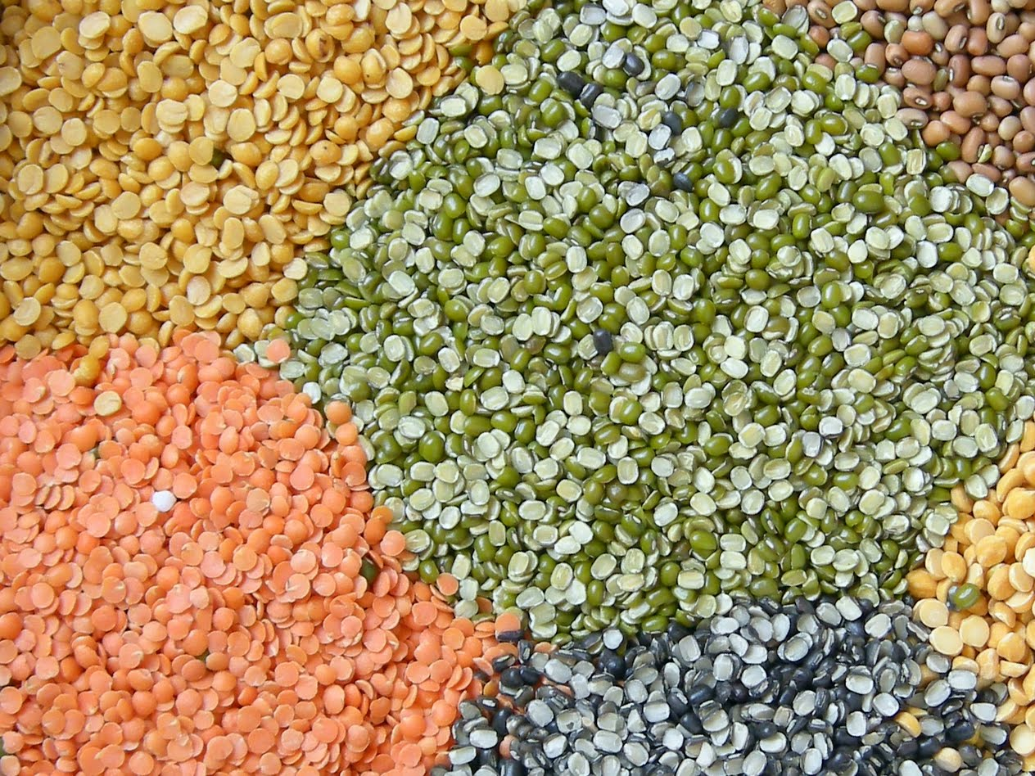
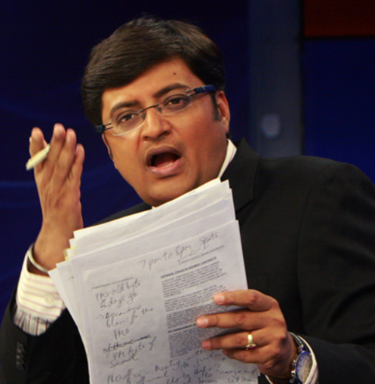
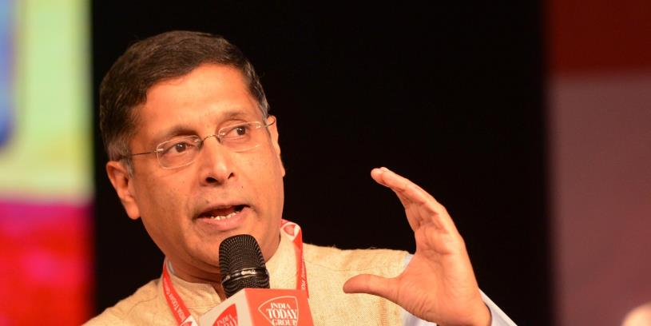
Pillar #4 ► Sectors of Economy ►Production ► inflation|GDP
Wedge between CPI, WPI
Wedge between Rural, Urban CPI
Is India’s GDP Overstated?
Inflationary Gap Deflationary spiral
Nation wants to know!! Why is this happening?
Ha bhai ha, I’ll explain…
Shantataa Theva

Slide 3
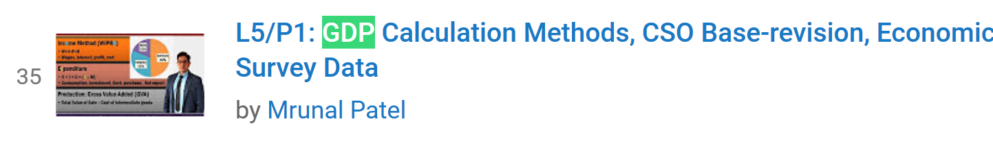
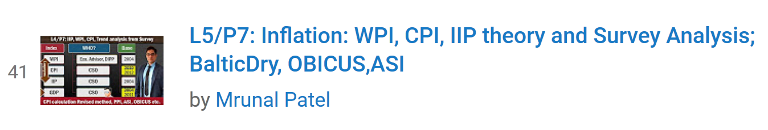

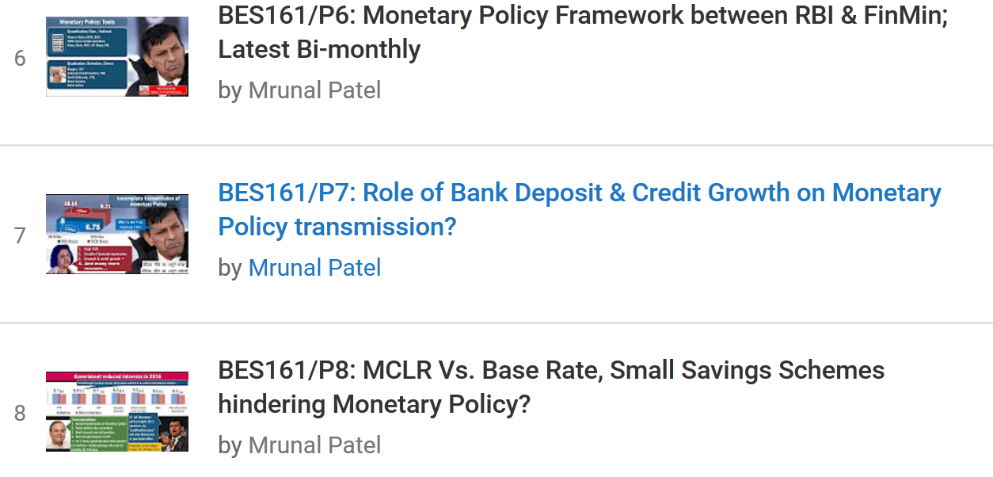

Slide 4
@full employment (ignore voluntary & Frictional)
Aggregate Demand (C+I+G)+(X-M)
J.M.Keyenes (UK, 1883)
“General Theory on employment, interest, money”
Full employment can happen only with Government spending on public works (Roosevelt’s Hoover dam, UPA’s MNREGA)
Consumption
Investment
Govt.
Purchase
GENERAL PRICE LEVEL
Aggregate Supply
Total output by all firms

Slide 5
Excess demand ► Inflationary gap
Aggregate Demand (C+I+G)+(X-M)
Aggregate Demand (C+I+G)+(X-M)
Inflationary Gap
“Demand Pull”
Consumption
Investment
Govt.
Purchase
Reasons: when ▲
Money supply
Fiscal deficit
Propensity to consume
Investment expdr.
Export
GENERAL PRICE LEVEL
Aggregate Supply
Total output by all firms
Already @full employment, so can’t increase production further
Homework: think of “supply-side / Cost-push” inflationary gap”
Notes:
24% hike by 7th PC
PM Uijawaala

Slide 6

UPSC ‘s CDS-2012-I
To combat inflationary pressure, what should be done?
Increase direct taxes
Reduce interest rates
Increase public Expenditure
Choices:
A): Only 1 ; B): Only 2;
C): Only 2 and 3; D): only 1 and 2
Money supply
Consumption, investment
Govt purchase
Consumption
Hint: Agg. Demand = Consump. + Investment + Govt Purchase + eXport – iMport

Slide 7
Deficient Demand ► Deflationary Gap
Aggregate Demand (C+I+G)+(X-M)
Aggregate Demand (C+I+G)+(X-I)
Reasons: when
▼ Money supply
▲ Fiscal consolidation
▲Propensity to SAVE;
▼Investment expenditure
▲ Import
Deflationary gap
Consumption
Investment
Govt.
purchase
GENERAL PRICE LEVEL
Aggregate Supply
Total output by all firms
Notes:
Solution – tax?

Slide 8


Best LCD TV. You’ll not get better price than this!!....buy it now!
No no…I’ll wait for the prices to drop even further….
Aggregate Demand shrinks even further
Aggregate Demand
Aggregate Supply
Total output by all firms

Slide 9
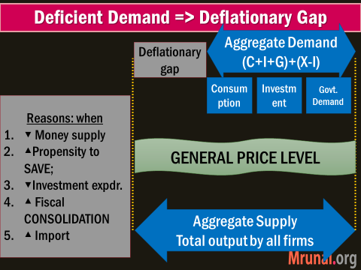
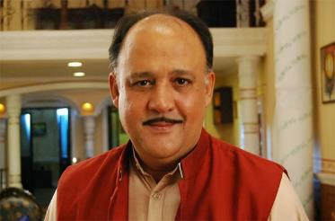
Year
2012
2015
Nominal Interest
9.25
Minus Inflation
-11%
-5.4%
Real Interest Rate
-1.75
7.00
+1.6
2017
7.00
+5%
+12%
My real purchasing power increasing.
I should save even more…so later I can buy more

Slide 10
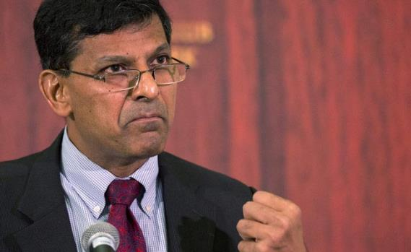


Why is RBI not reducing policy rate fast?
First I did not ▼, because had to stabilize inflation (2-6%)
When I ▼, banks did not transmit. BES161-P6-7
My Pikachu will defeat your Raichu
PS: I’m unable to win “Pokemon Go”, uske liye bhi Rajan hi jimmedaar hai.
But real value of my ‘debt’ increases. I may default on prev.loans
Consumption ▼► can’t expand, unless I get loans @cheaper rate
My real purchasing power ▲.
I should save even more…so later I can buy more..

Slide 11
Deflationary Gap► Deflationary spiral
Agg.Demand ▼
even further = deflationary gap ▲
Aggregate Demand (C+I+G)+(X-I)
Deflationary gap
Consumption ▼, Savings ▲
Investment ▼
Unemployment ▲
Bankruptcy, NPA ▲
Consumption
Investment
Govt.
Demand
GENERAL PRICE LEVEL
Aggregate Supply
Total output by all firms
Notes:
https://books.google.co.in/books?id=MJsJDKexrTcC&pg=PA282&dq=deflationary+spiral&hl=en&sa=X&ved=0ahUKEwjglqqH7o3OAhWHK48KHQRyDOgQ6AEIKDAC#v=onepage&q=deflationary%20spiral&f=false

Slide 12
Mock MCQ
Find correct statement
Deflationary spiral is a chain of events that worsen the deflation
Inflationary spiral is a chain of events that lead to deflation
Both A and B
Neither A nor B
Inflationary spiral = chain of events that worsen inflation

Slide 13
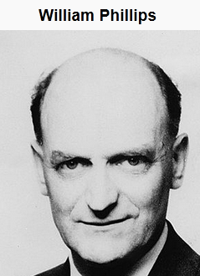





Philip curve
Inflation
But in the long run, it’ll be come Verticle i.e. “natural rate of unemployment” irrespective of inflation
Or buy dhoom-bike & become robber.
unemployment
Guess I’ll have to sell “Kabali” tickets in black.

Slide 14





Philip Curve: inflation ∝ 1/ unemployment
But Stagflation: inflation & unemployment both ▲
Reflation:
Using fiscal | monetary policy
Inflation
Demand-Pull
Cost-Push
General Price Level
Deflation
Rate of inflation
Creeping (single digit)
Galloping (double digit)
Hyperinflation (max.)
inflation favors the debtor over the lender.
Notes:
I borrow 1 dollar from you and buy 1 gallon of milk. We agree that I will pay you back in five years. When I pay you back, that 1 dollar will buy 1/32nd of a gallon of milk, or half a cup. Thus thanks to inflation, by going into debt, I was able to acquire a much larger amount of value, at a much earlier time, than the value I had to return to you in five years. Thus inflation favors the debtor over the lender.
Inflation speed
Low / creeping: Single digit
Galloping: 20, 30%....
Hyperinflation: Germany printing money before WW2
Phillips Curve
Inflation ►Less-unemployment
Stagflation: inflation & unemployment both ▲

Slide 15
Pillar #4 ► Sectors of Economy ►Production ► inflation|GDP
Wedge between CPI, WPI
Wedge between Rural, Urban CPI
Is India’s GDP Overstated?
Inflationary Gap Deflationary spiral
Nation wants to know!! Why is this happening?
Ha bhai ha, I’ll explain…
Shantataa Theva

Slide 16
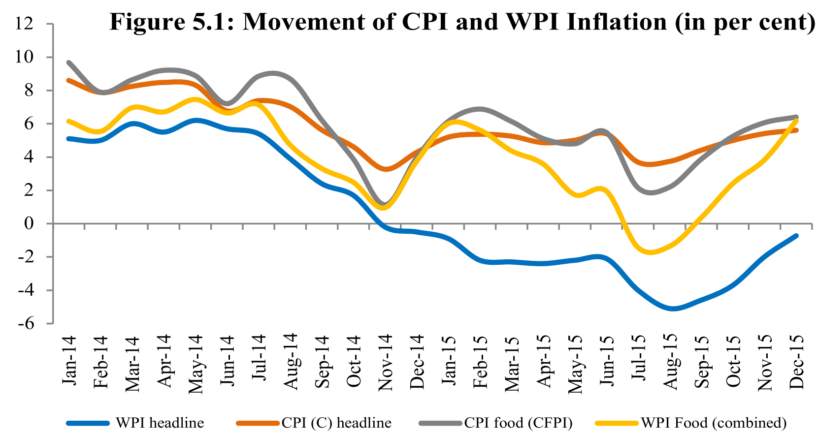
Wedge between CPI & WPI
CPI ~4% during same time-period
WEDGE?
WPI negative for conti. 14 months

Slide 17


Self study L5 Series before moving futher
Index
WPI
WHO?
Eco. Advisor, DIPP
CPI
IIP
CSO
CSO
GDP
CSO
Base
2004
2010 2012
2004
2004 2011
Laspeyres
L5/P1 .pptx

Slide 18
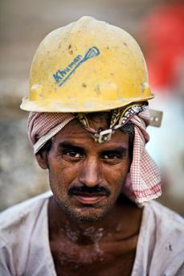

CPI for workers: Labour Bureau, Chandigarh/Shimla
Industrial Workers
2001=100
Rural Labourers
1986-87=100
Agricultural Labourers
1986-87=100
BASE YEAR
Notes:
Labour Bureau, Chandigarh/Shimla is engaged in collection, compilation, analysis and dissemination of labour statistics at all-India level on different facets of labour, such as, employment, wages and earnings, strikes and lockouts, absenteeism, labour turnover, labour cost, working and living conditions of workers, etc., both in organized and unorganized sector of industries. It also constructs, maintains and publishes Consumer Price Index Numbers for :
(i) Industrial Workers (Base 2001=100)
(ii) Rural Labourers (Base 1986-87=100)
Agricultural Labourers (Base 1986-87=100).

Slide 19




Wedge in WPI vs CPI ? ….Difference in base years
2004-----WPI------2016
2004-----CPI-----2016
8 years difference in base year
And basket of commodities, weights different
2012-----CPI-----2016

Slide 20
Side topic: base effect
110
10%
As such only +10 pts increase than previous base year.
But depending on the inflation in base year, the % varies
100
120
9.09%
110

Slide 21




Wedge because….Weight to food items
24.3%
45.9%
El Nino, 2 drought years, post-production losses
▼ Area under cultivation for pulses, oilseeds

Slide 22


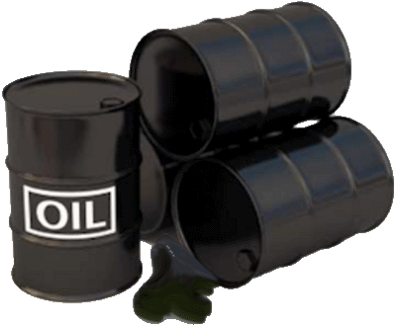
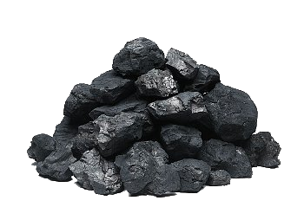
Wedge because…. Weight assigned to Fuel
40% of fuel basket= petrol diesel
70% of fuel basket= firewood & chips, electricity and dung cake

Slide 23
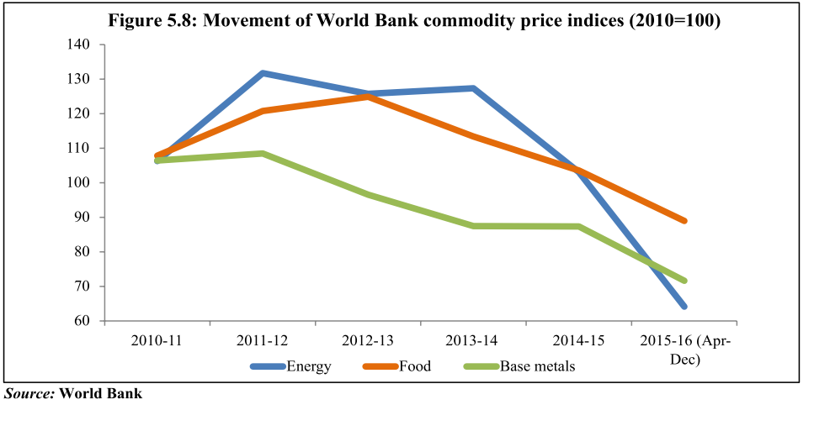



Wedge because…. Weight assigned to services
Services not counted
+ that much weight to tradable commodities, but global commodity prices ▼
Counted
Notes:
Tradable commodities have 55 per cent weight and fuel and power products about 15 per cent in the basket. On the other hand, the CPI basket consists of commodities as well as services like health and education which are not included in the WPI basket.
The CPI has negligible crude price pass through owing to negligible weight of petroleum products.

Slide 24
Eco Survey-2015; v2c5
Which of the following explain(s) the widening gap between CPI & WPI in recent months?
Difference in base years
Difference in weight assigned to fuel items
Difference in weight assigned to food items
All of above

Slide 25
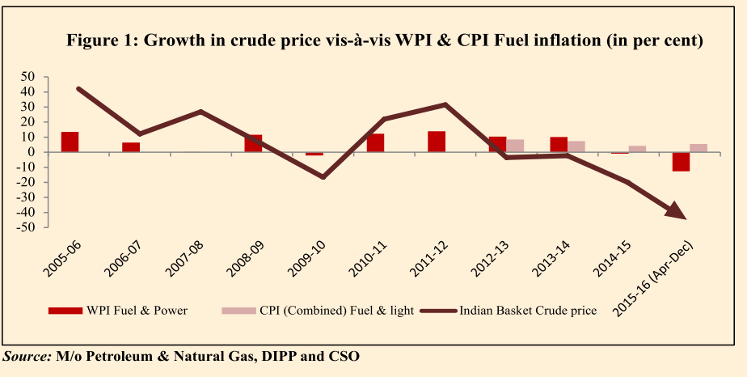
Eco Survey-2015; v2c5
Which of the following is/are the main cause(s) for negative trend in WPI?
Fall in global crude oil price
Fall in global commodity prices
Answer Choices
A. Only 1 B. Only 2
C. Both 1 & 2 D. None

Slide 26
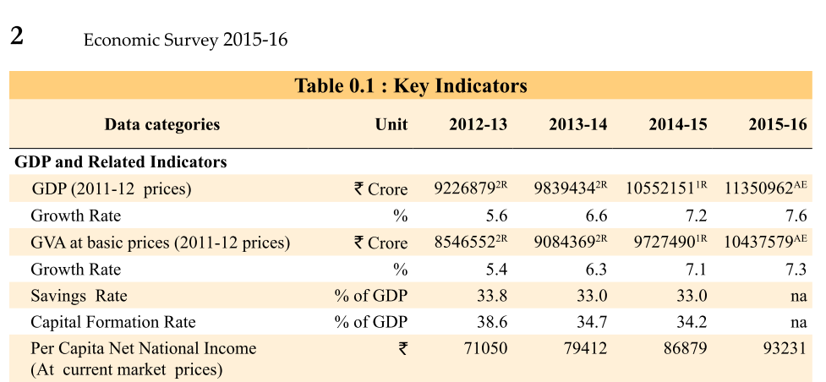
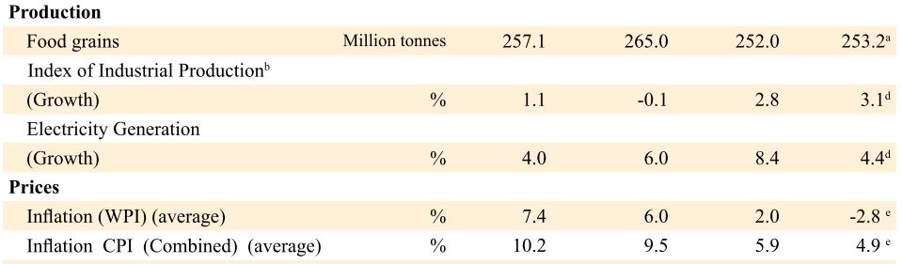
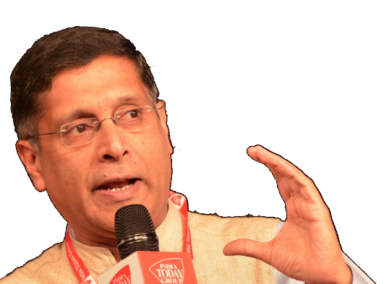
Numbers not important but sometimes they ask in clerical exams

Slide 27
Pillar #4 ► Sectors of Economy ►Production ► inflation|GDP
Wedge between CPI, WPI
Wedge between Rural, Urban CPI
Is India’s GDP Overstated?
Inflationary Gap Deflationary spiral
Nation wants to know!! Why is this happening?
Ha bhai ha, I’ll explain…
Shantataa Theva

Slide 28
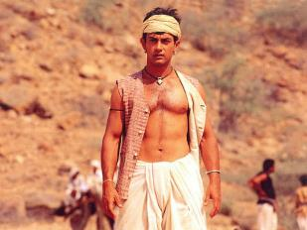
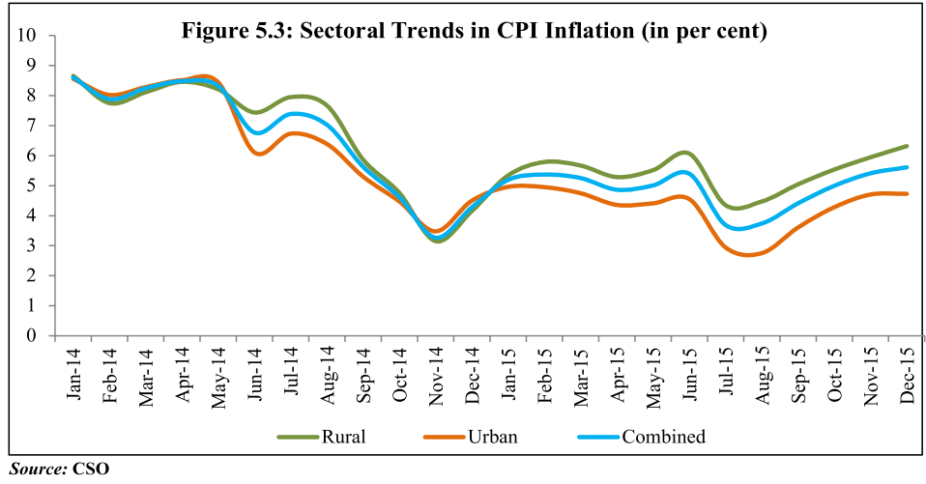





Why Rural inflation >> urban?

Slide 29

Why Rural > Urban inflation?
Urban CPI
▼ Fuel prices benefitted more (transport, energy)
Rural CPI
Higher weight to cereal, pulses, veggies: supply side constrains
MSP rise ► demand side

Slide 30

Prof. Angus Deaton, UK Noble’15
Who is not believing this?
2015-Noble Economics for analysis of consumption, poverty, and welfare.
Cities ought to have higher cost of living!!
CSO methods are faulty.
If separate lines for rural and urban then why not separate lines for Delhi vs. W.Bengal
Notes:
www.lse.ac.uk/publicEvents/pdf/2014-MT/20141209-Angus-Deaton-Robbins-Lecture-Series.pdf

Slide 31
Pillar #4 ► Sectors of Economy ►Production ► inflation|GDP
Wedge between CPI, WPI
Wedge between Rural, Urban CPI
Is India’s GDP Overstated?
Inflationary Gap Deflationary spiral
Nation wants to know!! Why is this happening?
Ha bhai ha, I’ll explain…
Shantataa Theva

Slide 32
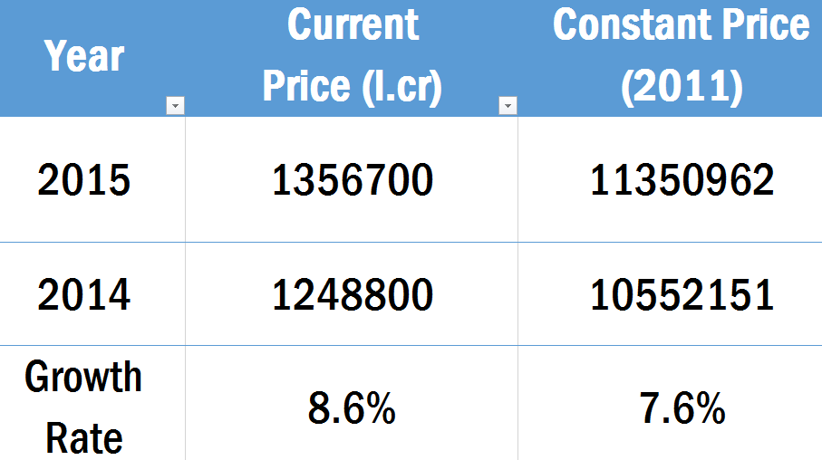
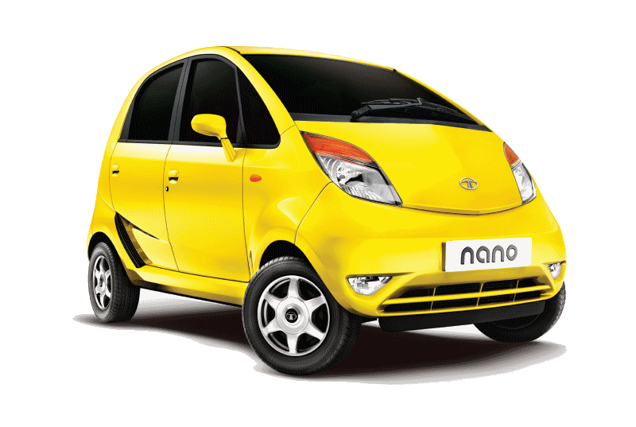
Calculating 2015 growth rate (Current price)
Rs. 1.08 lakh per car
Rs. 1 lakh per car

Slide 33
Calculating 2015 growth rate (Constant price)
Adjust with inflation

Slide 34
Numbers not important but sometimes they ask in clerical exams

Slide 35
GDP overstated by 250 basis points
GDP @Current Price
GDP
@Constant Price
@Real Price
GDP Deflator
10 | 10
2 | 5
Released on quarterly basis
More weight to WPI
Not showing true picture .

Slide 36
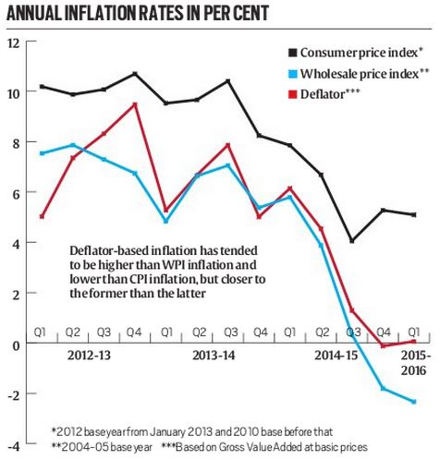
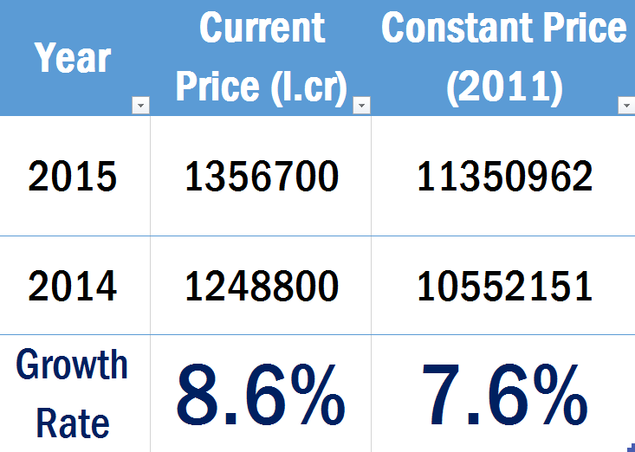
GDP overstated by 250 basis point
-2.5%
=5.1%

Slide 37
Prof. Angus Deaton, born @UK, teach @US
Who is alleging this?
India's GDP growth is lower than official numbers.
India's poverty levels higher than official numbers.
Req. 250 years for Indian women to grow as tall as British
CSO, NSSO: less funded, less trained than USA. + governance is weak.

Slide 38
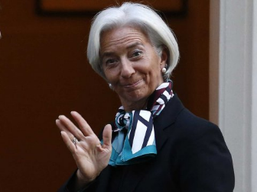
IMF’s World Economic Outlook (WEO) 2016
Exact numbers not important
But who publishes which report? That’s important
Notes:
http://www.imf.org/external/pubs/ft/weo/2016/update/01/

Slide 39
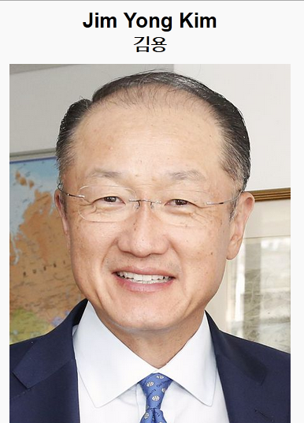
World Bank’s Global Economic Prospect (India- June’16 update)
Exact numbers not important. But who publishes which report? That’s important..
Notes:
Released in 2016, June

Slide 40
Prof. Angus Deaton Noble Economics 2015
Who is not believing this?
Conflict of interest : IMF, World bank, WTO, FAO, UN etc. produce data by which their ‘success’ is judged.
Limited oversight on international statistics
@theHindu, are you interested in hiring me as columnist? :P :P :P
Notes:
http://www.lse.ac.uk/publicEvents/pdf/2014-MT/20141209-Angus-Deaton-Robbins-Lecture-Series.pdf

Slide 41
Report vs. author
Which of the following report is incorrectly matched?
World Economic Outlook : IMF
Global Economic Prospects: WB
Global Risk Report: World Economic forum
None of above

Slide 42
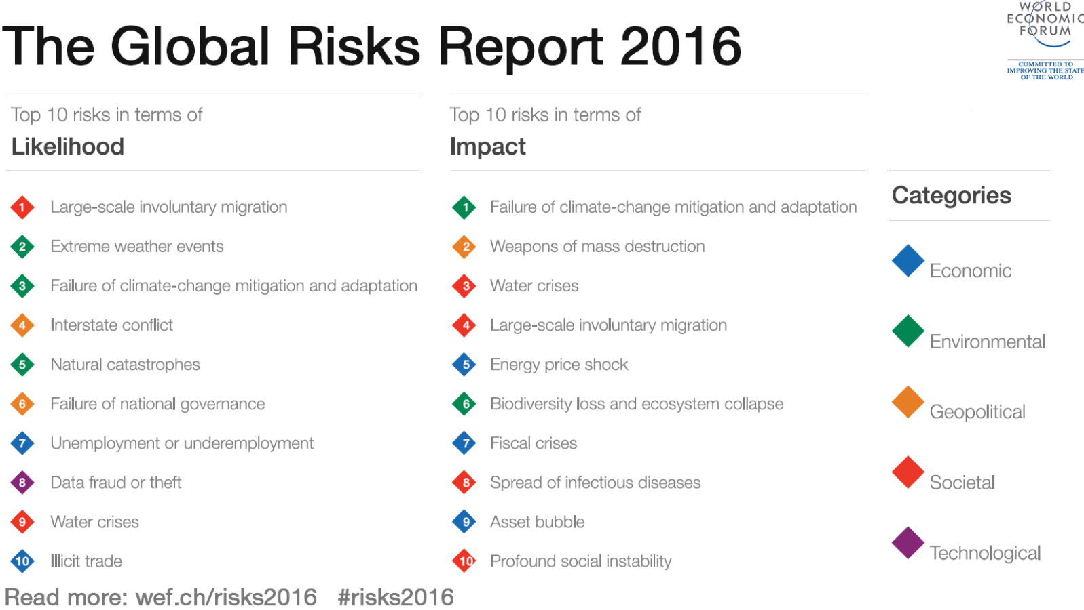

Slide 43
Pillar #4 ► Sectors of Economy ►Production ► inflation|GDP
Wedge between CPI, WPI
Wedge between Rural, Urban CPI
Is India’s GDP Overstated?
Inflationary Gap Deflationary spiral
Nation wants to know!! Why is this happening?
Ha bhai ha, I’ll explain…
Shantataa Theva

Slide 44
Theory +Economic Survey Vol.2 + Vol.1 + Budget 2016
1.Banking Finance
6.HRD
2.Budget-Fiscal Policy
3.BoP
4.Sectors of Economy
5.Infra
V2C2-Pub.Fin; V1C3-JAM
V2C3-Monetary mgmt+FI
V2C4-External sector
V2C5-Price,Agri.; V2C6,7
V2C8-Paris Summit, Energy
V2C9-Social infra.
V1C4-Agri ; V1C9-Fertilizer
V1C5-mother-child
V1C6-bounties; V1C7-Fiscal Cap
V1C8-PTA
V1C2-Chakravy; V1C10-Labour
V1C11-Powering 1 India
B1. Financial Sector Reforms
B2. Fiscal Discipline
B3. Tax Reforms; B4. Ease of
B5. Agro: 2x farmer income
B6. Rural infra-employment
B7. Infrastructure
B8. Social Sector & healthcare
B9. Education, Skills, Jobs
V2C1- Chakravyuh challenge
V1C1- Twin Balancesheet
IYB:7-Commerce
Agri
Mfg
MicroEcon
GDP Inflation

Slide 45

BES165► Infrastructure, Environment
Nuke Energy NSG, HELP-2016
Postal, Telecom, Mass.Comm (YB)
Kelkar-PPP
Rail Budget CAP-2016
Urban Infra-Bills.
Paris Summit Clean Energy

Slide 46
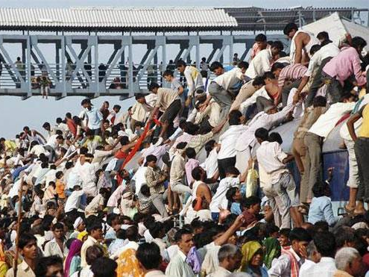
BES166► Human Resource development
Census Theory
Education New Policy 2016
Health & Welfare Women, Children
HDR’15 | SDG’16-30

